Slide 1
An Asymmetric Similarity Measure for Tag Clustering on Flickr
Xiaochen Huang et. al (IEEE APWEB ’10)
Presenter : Chiang, Guang-ting
Advisor: Dr. Koh. Jia-ling
Date: 2011/9/26

Slide 2
outline
Introduction
Tag similarity measures
Tag refinement
Evaluation
Conclusion

Slide 3
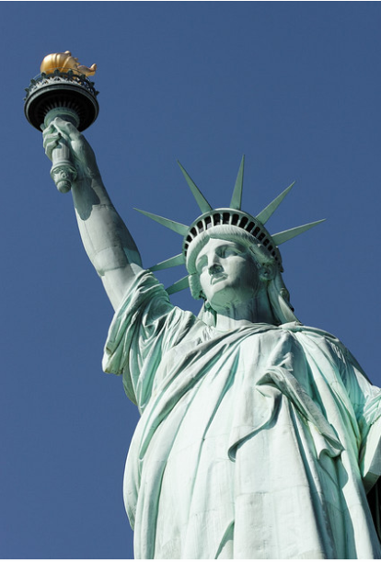
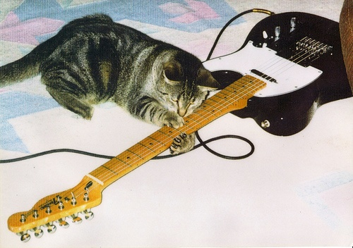
Introduction
The social tagging systems provide Internet users new options to organize, categorize, search and explorer resources.
Tagging systems do not have an agreed structure of tags or detailed taxonomy.
莫那魯道,
賽德克．巴萊,霧社
cat, play, cat tale, guitar
New York,USA
Liberty Statue, landmark
Notes:
Tag 可以表達object的概念 主題 位置 動作…

Slide 4
Introduction CONT.
Advantages:
The overall costs for users of these tagging systems in terms of time, effort and cognition are far lower than the costs of systems that rely on complex hierarchal classification and categorization schemes
Drawbacks:
Tags can be redundant or ambiguous due to their open nature, which will greatly limit the performance.
Notes:
花費低 比較起其他階層化分類 或 分類的計畫

Slide 5
Tag similarity measures
Tag relations
Current Measures
TCSM (Tag Co-occurrence Similarity Measure)
UCSM (User Count Similarity Measure)
Propose method
RFSM (Reliability Factor Similarity Measure)

Slide 6
Tag relations
Tag similarity measures cont.
Based on the analysis of Flickr’s data set, we recognize four types of useful tag relations:
Parent-Child Relations (“ has a ”)
Parents of a child can be used to construct context of that child which can greatly enhance user’s understanding.
ex:Sydney – Harbour Bridge and Japan - Tokyo
Hypernym-Hyponym Relations (“ is a ”)
ex:dog - Labrador and furniture - desk.
Both types of relations are very useful in solving basic level variation semantic difficulty when the tags involved in these relations are both of “ topic ” or “ location ” type.

Slide 7
Tag relations
Tag similarity measures cont.
Token-Phrase Relations
Some phrases entered by users for tagging purpose are wrongly broken down into separate tokens by the system, which in turn become individual tags.
ex:new - york and san - francisco.
Capturing these relations can help us reconstruct users’ original intentions.
Synonym Relations
In a broad sence, abbreviations, singular-plural forms and language variations are also included in this type.
ex:manzana and apple may form a sysnonym relation as manzana is a Spanish word meaning apple on the web.
Notes:
單字 - 片語:
同義字:

Slide 8
Current Measures
Tag similarity measures cont.
TCSM (Tag Co-occurrence Similarity Measure):
$sim(t_{i},t_{j})=\frac{c(t_{i},t_{j})}{c(t_{i})}$
where $t_{i}$and $t_{j}$ are two tags, $c(t_{i},t_{j})$ is the tag co- occurrence count of $t_{i}$and $t_{j}$, and $c(t_{i}$) is the tag frequency of $t_{i}$.
It can be problematic when some active users tagged much more resources than others. The similarity measurement will be easily biased in favor of those active users.

Slide 9
Current Measures
Tag similarity measures cont.
UCSM (User Count Similarity Measure):
$sim(t_{i},t_{j})=\frac{u(t_{i},t_{j})}{u(t_{i})}$
where $t_{i}$and $t_{j}$ are two tags, $u(t_{i},t_{j})$ is the number of users that assign both $t_{i}$and $t_{j}$ to a same resource, and u$(t_{i}$) is the number of users that use $t_{i}$.
It may over-emphasize the user impact by totally ignoring the tag co-occurrencevalue.
Notes:
我

Slide 10
Propose method
Tag similarity measures cont.
RFSM (Reliability Factor Similarity Measure):
$sim\left(t_{i},t_{j}\right)=\text{SF} \left(t_{i},t_{j}\right)∗\text{RF} \left(t_{i},t_{j}\right)$
$\text{SF}$ (similarity factor):
tag co-occurrence normalized by the frequency of one of the tags is a good indicator of tag relations, and thus can be used as a start point of similarity measures.
SF$(t_{i},t_{j})=\frac{c(t_{i},t_{j})}{c(t_{i})}$

Slide 11
Propose method
Tag similarity measures cont.
RFSM (Reliability Factor Similarity Measure):
$sim\left(t_{i},t_{j}\right)=\text{SF} \left(t_{i},t_{j}\right)∗\text{RF} \left(t_{i},t_{j}\right)$
$\text{R}\text{F}$ (reliability factor):
when high frequency tag pairs are used by only a small portion of users, relations between these tags are highly unreliable.

Slide 12
Tag refinement
In the process of tag clustering we observe that some tags can be clustered together for wrong reasons and form useless concepts for users.
Problematic Relations
Tag Refining Rules

Slide 13
Problematic Relations
Tag refinement cont.
Token-phrase relations :
Ex: Cluster { new, york, zealand } is incorrectly clustered together because New York and New Zealand are separated into individual words.
synonym relations :
Acronyms :
Ex: AI can be expanded to artificial intelligence, art institute, Allen Iverson and etc. With the noum of AI, all words associated with these different concepts may be grouped as one cluster.
Singular-plural relation :
Ex: apple and apples .If the relation between apple and apples is not strong enough, two clusters may be generated albeit there should be only one.

Slide 14
Tag Refining Rules
Tag refinement cont.
Token-phrase relations :
we detect token-phrase relations by examining if one tag is strongly related to another while they together can form a phrase tag.
Once such a relation is discovered, all the co-appearances of the two token tags involved will be replaced by the phrase tag.
Acronyms :
By testing if one tag is formed by the initial components of another tags source phrase,we can estimate whether or not the former one is an acronym of the latter one.
To avoid problems brought by acronyms, when a tag and its acronym appear in a photos tag set, the acronym tag will be discarded.
Singular-plural relation :
It can be detected using simplified version of the Porter Stemming Algorithm.
Notes:
1.兩個tag之間的連接性強不強 是否有同時一起出現
2.看縮寫字跟另一個tag它組成的成分
3. Porter Stemming Algorithm.

Slide 15
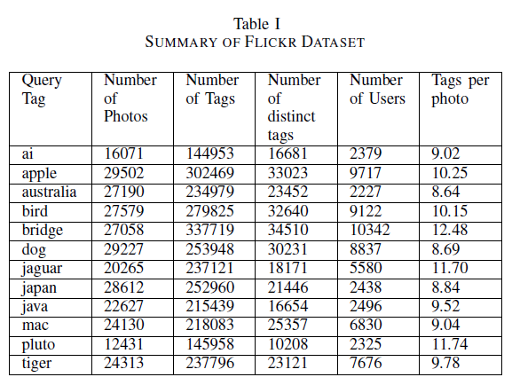
Evaluation
Data sets
Use flickr API functions flickr.photos.search and flickr.photos.getInfo during the period from February to April 2009.
Twelve query tags are chosen featuring different types of potential outcomes.
Notes:
選擇12個查詢標籤考慮到其具有不同類型的潛在結果

Slide 16
Evaluation CONT.
Clustering Result Comparison
set up several cluster categories
select the top 20 clusters from cluster results and assign them into the predefined categories.
use the number of clusters in each category to compare the effectiveness of the three measures.
Notes:
set up several cluster categories which have the potential to meet certain information needs of users.
select the top 20 clusters from cluster results of that tag generated using each similarity measure and assign them into the predefined categories.
We use the number of clusters in each category to compare the effectiveness of the three measures. The ranking of clusters is based on the number of tags contained. Clusters having more tags will be ranked higher.

Slide 17
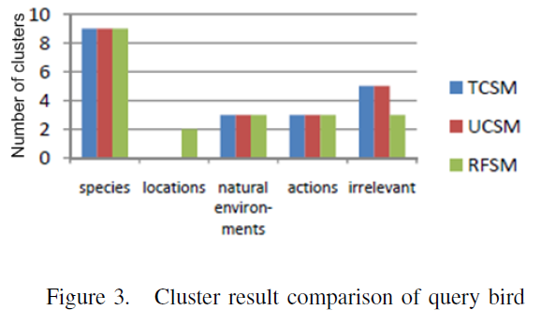
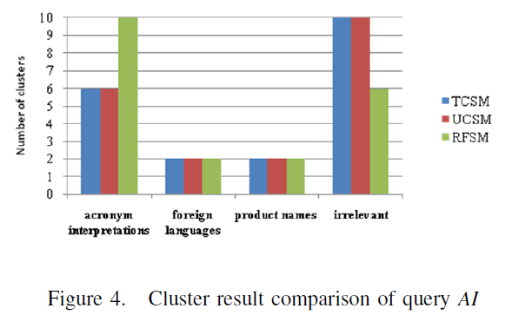

Slide 18
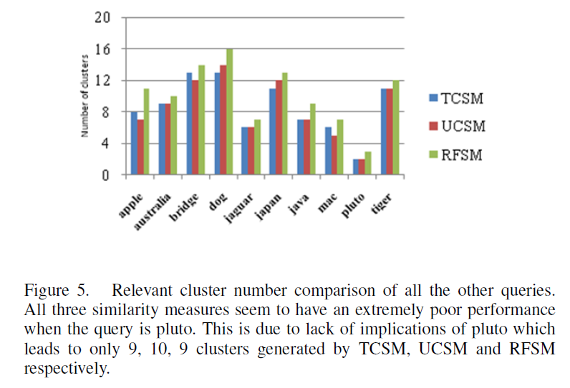
For the other ten query tags

Slide 19
Evaluation CONT.
Effectiveness of Tag Refining Strategies
Use RFSM as the similarity measure.
Measure the accuracy of the tag refinement rules we’ve generated. (250 tag refinement rules)
Compare the cluster results generated with and without tag refinement.
relations | No. of relation | ratio
Singular-plural | 182 | 181/182 = 0.994
Acronyms | 32 | 32/32 = 1
Token-phrase | 36 | 31/36 = 0.861

Slide 20
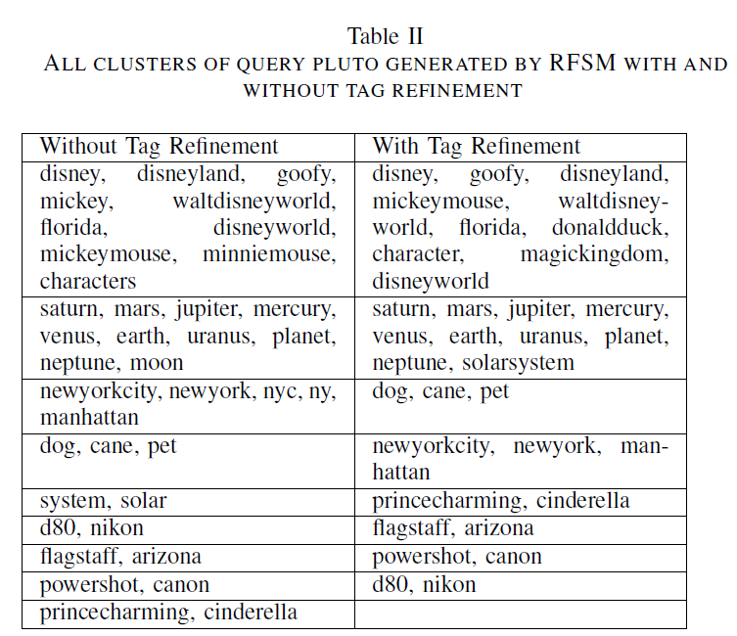

Slide 21
conclusion
proposed a new similarity measure RFSM which can better quantify the tag relations.
presented an alternative way of utilizing discovered tag relations to set up tag refining rules, which can in turn improve the precision of tag relations.
Experiments suggest that our method can significantly improve the tag clustering results.

Slide 22
Thx for ur listening

Slide 23
supplement

Slide 24
Co-occurrence
Given a Dataset
t1= {a, b, c}
t2= {a, b, d, e}
t3= {a, b, f}
t4= {d, e, g}
t5= {b, c, f, g}
t6= {b, c}
t7= {a, d, e}
t8= {b, f}
t9= {a, e, g}
t10= {b, f, g}
$$sim(t_{i},t_{j})=\frac{c(t_{i},t_{j})}{c(t_{i})}$$
$sim(t_{i},t_{j})$=c$(t_{i},t_{j})$
Co-occurrence of sim(a,b)
= 3
$$\frac{3}{5}=0.6$$

Slide 25
Stemming
將詞型、時態變化還原成原型以縮短搜尋時間、增加效率。
EX
詞型、時態變化 | 原型
Stems | stem
stemmed | stem
stemming | stem
related | relate
relation | relate
relative | relate

Slide 26
Porter Stemming ALGORITHM
Step 1：將字尾有母音的es、e、ed、y替換掉
如： searched →search
Step 2：將字尾為tional、fulness、iveness等，替換成tion、 ful、ive等等
如：traditional →tradition
Step 3：將字尾為icate、iveness、alize等，替換成ic、ive、al
等等
如：specializes → special
Step 4：刪除剩餘的標準字尾，例如al、ance、er、ic等等
如：magical → magic
Step 5：去除字尾沒有母音的e
如：because → becaus

